Slide 1
Clipping
Cohen-Sutherland Algo

Slide 2
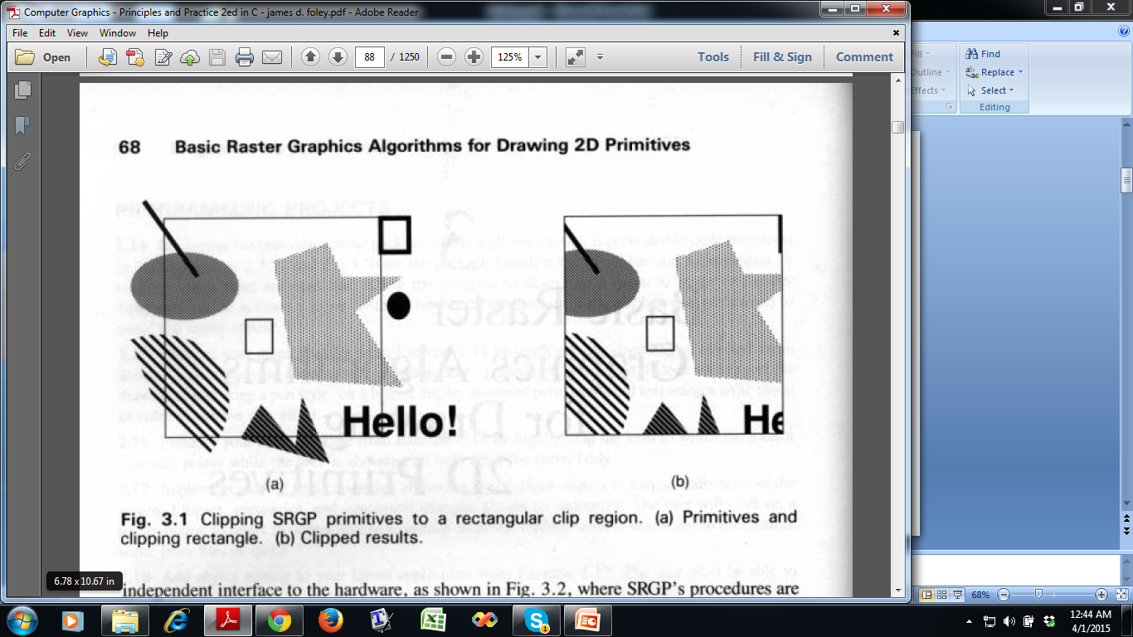
What is Clipping?

Slide 3
Clipped view in screen

Slide 4
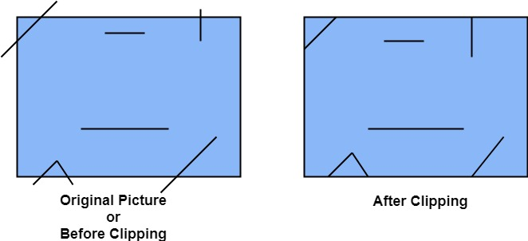
Line Clipping

Slide 5
Clipping in a Raster World
Clipping techniques
Analytical
Lines, polygons etc.
Floating point graphics package
During scan conversion (scissoring)
Checking extrema suffices, internal points can be ignored
Circles, curves etc.
During writing a pixel
Outline primitive not much larger, few pixels are clipped

Slide 6
A point (x,y) is not clipped if:
x_{min} ≤ x ≤ x_{max} AND y_{min} ≤ y ≤ y_{max}
otherwise it is clipped
P₄
Clipped
Clipped
Window
P₂
y_{max}
Clipped
P₅
P₅
P₁
P₇
P₁
Points Within the Window are Not Clipped
P₉
P₉
y_{min}
P₈
Clipped
P₁₀
x_{min}
x_{max}

Slide 7
P₄
Window
Window
y_{max}
y_{max}
P₆
P₆
P₃
P₅
P₅
P₇
P’₇
P₉
P₈
P₉
P’₈
y_{min}
y_{min}
P’₁₀
P₁₀
P₁₃
P₁₄
x_{min}
x_{max}
x_{min}
x_{max}

Slide 8
World space is divided into regions based on the window boundaries
Each region has a unique four bit outcode
Outcodes indicate the position of the regions with respect to the window
1001 | 1000 | 1010
0001 | 0000 Window | 0010
0101 | 0100 | 0110
3
2
1
0
above
below
right
left
Region Code

Slide 9
World space is divided into regions based on the window boundaries
Each region has a unique four bit outcode
Outcodes indicate the position of the regions with respect to the window
P₃
1001 | 1000 | 1010
0001 | 0000 Window | 0010
0101 | 0100 | 0110
3
2
1
0
above
below
right
left
P₄
P₁
Region Code
P₂

Slide 10
Calculate_outcode(x,y){
if (x<x_{min}) bit0 =1
else bit0=0
if (x>x_{max}) bit1=1
else bit1=0
if(y<y_{min}) bit2=1
else bit2=0
if (y>y_{max}) bit3=1
else bit3=0
}
3
2
1
0
above
below
right
left
Region Code

Slide 11
Calculate_outcode(x,y){
if (x<x_{min}) bit0 =1
else bit0=0
if (x>x_{max}) bit1=1
else bit1=0
if(y<y_{min}) bit2=1
else bit2=0
if (y>y_{max}) bit3=1
else bit3=0
}
P₁₁ [1010]
P₄ [1000]
Window
y_{max}
P₆ [0000]
P₃ [0001]
P₅ [0000]
P₁₂ [0010]
P₇ [0001]
P₉ [0000]
P₈ [0010]
y_{min}
P₁₀ [0100]
P₁₃ [0101]
P₁₄ [0110]
x_{min}
x_{max}
3
2
1
0
above
below
right
left
Region Code

Slide 12
Calculate_outcode(x,y,z){
if (x<x_{min}) bit0 =1
else bit0=0
if (x>x_{max}) bit1=1
else bit1=0
if(y<y_{min}) bit2=1
else bit2=0
if (y>y_{max}) bit3=1
else bit3=0
if(z<z_{min}) bit2=1
else bit2=0
if (z>z_{max}) bit3=1
else bit3=0
}
5
4
3
2
1
0
Far
Near
above
below
right
left
Region Code

Slide 13
cohen-Sutherland(x1, y1, x2, y2):
oc1 = calculate_outcode(x1, y1),
oc2 = calculate_outcode(x2, y2);
while(true) {
if(oc1 == oc2 == 0000) {
//declare completely inside
output (x1, y1), (x2, y2) as clipped line
break
}
else if((oc1 AND oc2)!=0000){ // condition to check matching bit
//declare completely outside and clip
break
}
else{
if(oc1 != 0000){
(x1, y1) = find intersection point of line
and the boundary corresponding
to non-zero bit of oc1
oc1 = calculate_outcode(x1, y1)
}
else{
(x2, y2) = find intersection point of line
and the boundary corresponding
to non-zero bit of oc2
oc2 = calculate_outcode(x2, y2)
}
continue
}

Slide 14
cohen-Sutherland(x1, y1, x2, y2):
oc1 = calculate_outcode(x1, y1),
oc2 = calculate_outcode(x2, y2);
while(true) {
if (oc1 == oc2 == 0000) {
//declare completely inside
output (x1, y1), (x2, y2) as clipped line
break
}
else if ((oc1 AND oc2)!=0000) { // condition to check matching bit
//declare completely outside and clip
break
}
else{
if(oc1 != 0000){
(x1, y1) = find intersection point of line
and the boundary corresponding
to non-zero bit of oc1
oc1 = calculate_outcode(x1, y1)
}
else{
(x2, y2) = find intersection point of line
and the boundary corresponding
to non-zero bit of oc2
oc2 = calculate_outcode(x2, y2)
}
continue
}
P₂ [1010]
Window
y_{max}
y_{min}
P₁ [0101]
x_{min}
x_{max}

Slide 15
cohen-Sutherland(x1, y1, x2, y2):
oc1 = calculate_outcode(x1, y1),
oc2 = calculate_outcode(x2, y2);
while(true) {
if (oc1 == oc2 == 0000) {
//declare completely inside
output (x1, y1), (x2, y2) as clipped line
break
}
else if ((oc1 AND oc2)!=0000) { // condition to check matching bit
//declare completely outside and clip
break
}
else{
if(oc1 != 0000){
(x1, y1) = find intersection point of line
and the boundary corresponding
to non-zero bit of oc1
oc1 = calculate_outcode(x1, y1)
}
else{
(x2, y2) = find intersection point of line
and the boundary corresponding
to non-zero bit of oc2
oc2 = calculate_outcode(x2, y2)
}
continue
}
P₂ [1010]
Window
y_{max}
y_{min}
P₁’ [0001]
x_{min}
x_{max}

Slide 16
cohen-Sutherland(x1, y1, x2, y2):
oc1 = calculate_outcode(x1, y1),
oc2 = calculate_outcode(x2, y2);
while(true) {
if (oc1 == oc2 == 0000) {
//declare completely inside
output (x1, y1), (x2, y2) as clipped line
break
}
else if ((oc1 AND oc2)!=0000) { // condition to check matching bit
//declare completely outside and clip
break
}
else{
if(oc1 != 0000){
(x1, y1) = find intersection point of line
and the boundary corresponding
to non-zero bit of oc1
oc1 = calculate_outcode(x1, y1)
}
else{
(x2, y2) = find intersection point of line
and the boundary corresponding
to non-zero bit of oc2
oc2 = calculate_outcode(x2, y2)
}
continue
}
P₂ [1010]
Window
y_{max}
P₁’’ [0000]
y_{min}
x_{min}
x_{max}

Slide 17
cohen-Sutherland(x1, y1, x2, y2):
oc1 = calculate_outcode(x1, y1),
oc2 = calculate_outcode(x2, y2);
while(true) {
if (oc1 == oc2 == 0000) {
//declare completely inside
output (x1, y1), (x2, y2) as clipped line
break
}
else if ((oc1 AND oc2)!=0000) { // condition to check matching bit
//declare completely outside and clip
break
}
else{
if(oc1 != 0000){
(x1, y1) = find intersection point of line
and the boundary corresponding
to non-zero bit of oc1
oc1 = calculate_outcode(x1, y1)
}
else{
(x2, y2) = find intersection point of line
and the boundary corresponding
to non-zero bit of oc2
oc2 = calculate_outcode(x2, y2)
}
continue
}
Window
y_{max}
P₂ ’ [0000]
P₁’’ [0000]
y_{min}
x_{min}
x_{max}

Slide 18
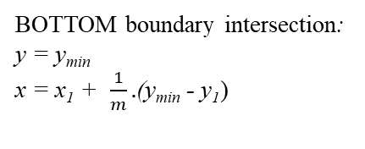
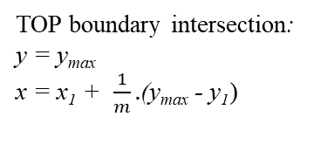
P₂
(x, y)
P₂
y_{max}
y_{max}
(x, y)
y_{min}
y_{min}
LEFT boundary intersection:
x = x_{min} y = y₁ + m (x_{min} - x₁)
P₁
RIGHT boundary intersection:
x = x_{max} y = y₁ + m (x_{max} - x₁)
P₁
x_{min}
x_{max}
x_{min}
x_{max}
P₂
P₂
(x, y)
y_{max}
y_{max}
(x, y)
y_{min}
y_{min}
P₁
P₁
x_{min}
x_{max}
x_{min}
x_{max}

Slide 19
Determine whether the following line are accepted/rejected/partial using Cohen Sutherland line clipping algorithm.
a) Given (-250,-200) to (250,200) be the clip region.
(i) (-100, -220) to (300, -210).
(ii) (-250, 200) to (250, -200).
b) Given (0,0) to (300,200) be the clip region.
(i) (50, -125) to (-100, 225).
(ii) (-250, 200) to (250, -200).
If they are partially accepted/rejected find the line segment within the clipping window.

Slide 20
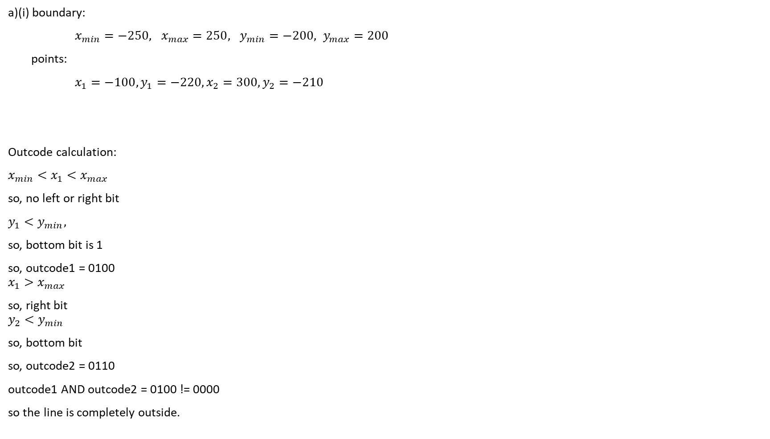
cohen-Sutherland(x1, y1, x2, y2):
oc1 = calculate_outcode(x1, y1),
oc2 = calculate_outcode(x2, y2);
while(true) {
if (oc1 == oc2 == 0000) {
//declare completely inside
output (x1, y1), (x2, y2) as clipped line
break
}
else if ((oc1 AND oc2)!=0000) { // condition to check matching bit
//declare completely outside and clip
break
}
else{
if(oc1 != 0000){
(x1, y1) = find intersection point of line
and the boundary corresponding
to non-zero bit of oc1
oc1 = calculate_outcode(x1, y1)
}
else{
(x2, y2) = find intersection point of line
and the boundary corresponding
to non-zero bit of oc2
oc2 = calculate_outcode(x2, y2)
}
continue
}

Slide 21
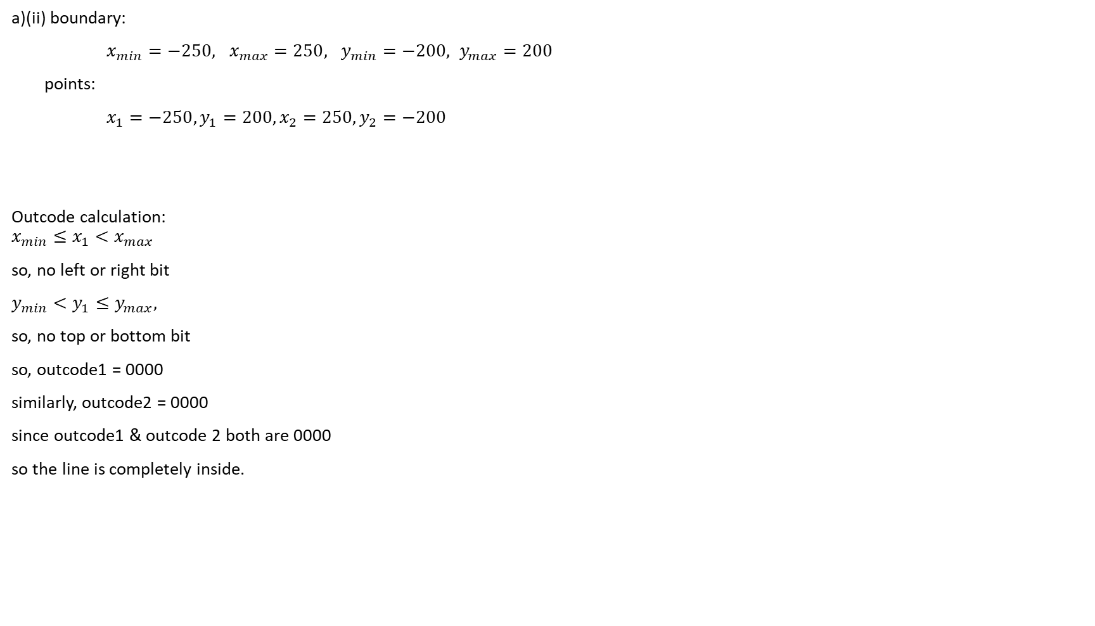
cohen-Sutherland(x1, y1, x2, y2):
oc1 = calculate_outcode(x1, y1),
oc2 = calculate_outcode(x2, y2);
while(true) {
if (oc1 == oc2 == 0000) {
//declare completely inside
output (x1, y1), (x2, y2) as clipped line
break
}
else if ((oc1 AND oc2)!=0000) { // condition to check matching bit
//declare completely outside and clip
break
}
else{
if(oc1 != 0000){
(x1, y1) = find intersection point of line
and the boundary corresponding
to non-zero bit of oc1
oc1 = calculate_outcode(x1, y1)
}
else{
(x2, y2) = find intersection point of line
and the boundary corresponding
to non-zero bit of oc2
oc2 = calculate_outcode(x2, y2)
}
continue
}

Slide 22
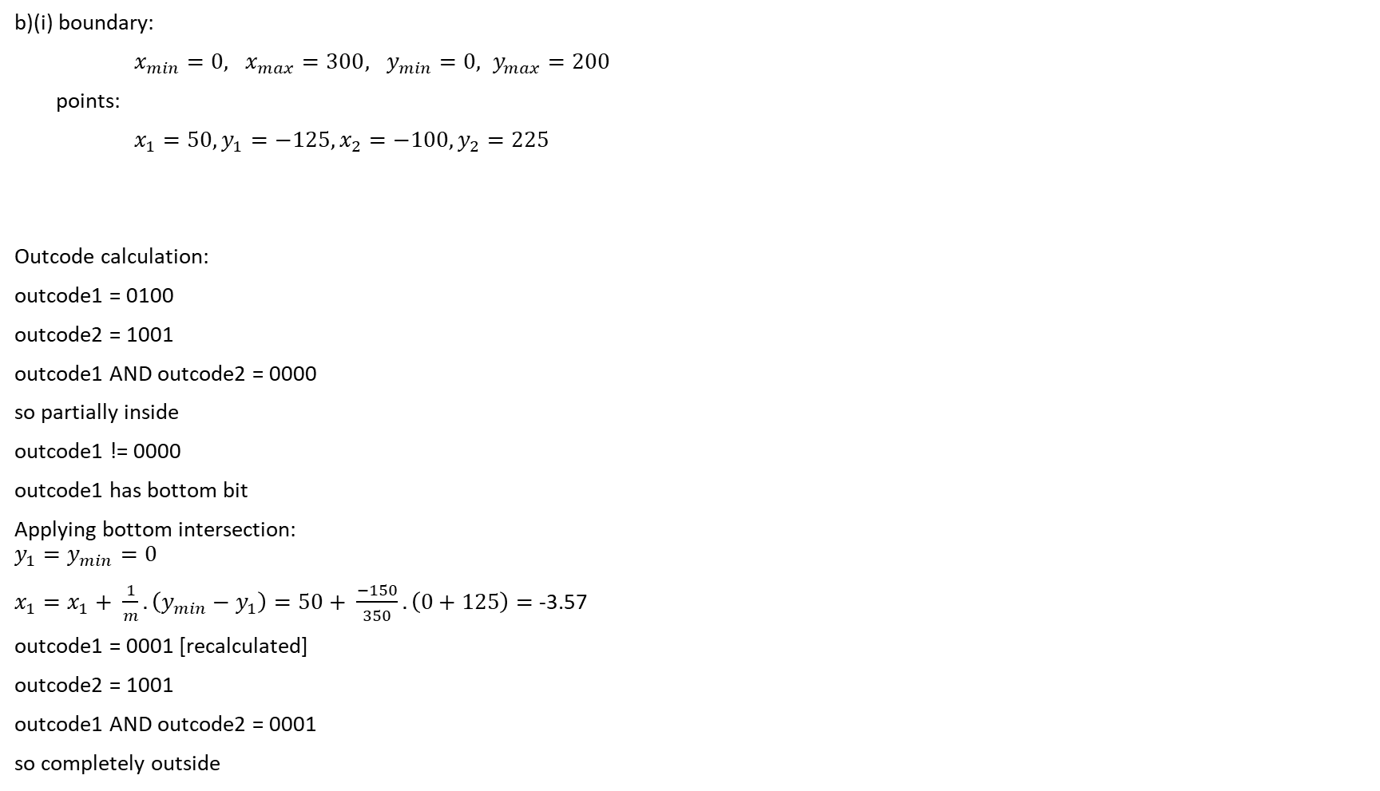
cohen-Sutherland(x1, y1, x2, y2):
oc1 = calculate_outcode(x1, y1),
oc2 = calculate_outcode(x2, y2);
while(true) {
if (oc1 == oc2 == 0000) {
//declare completely inside
output (x1, y1), (x2, y2) as clipped line
break
}
else if ((oc1 AND oc2)!=0000) { // condition to check matching bit
//declare completely outside and clip
break
}
else{
if(oc1 != 0000){
(x1, y1) = find intersection point of line
and the boundary corresponding
to non-zero bit of oc1
oc1 = calculate_outcode(x1, y1)
}
else{
(x2, y2) = find intersection point of line
and the boundary corresponding
to non-zero bit of oc2
oc2 = calculate_outcode(x2, y2)
}
continue
}

Slide 23
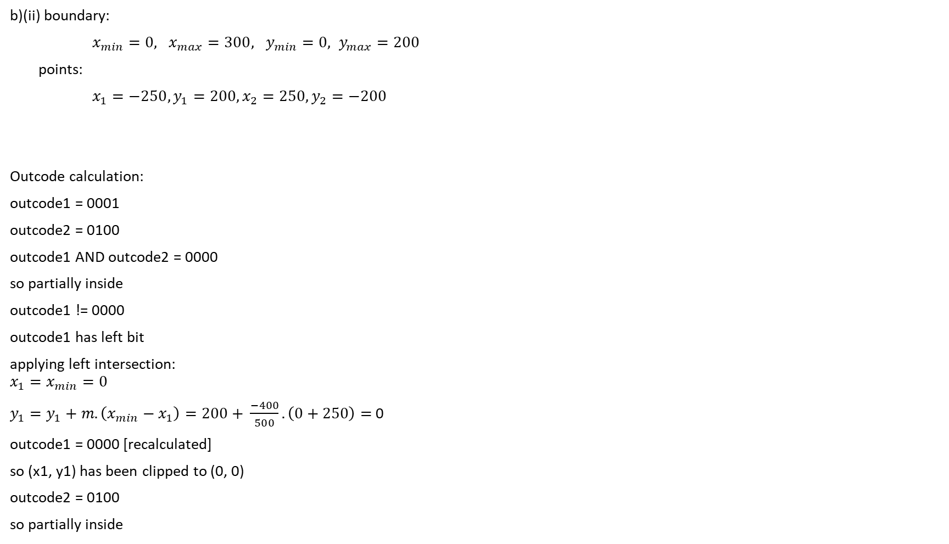
cohen-Sutherland(x1, y1, x2, y2):
oc1 = calculate_outcode(x1, y1),
oc2 = calculate_outcode(x2, y2);
while(true) {
if (oc1 == oc2 == 0000) {
//declare completely inside
output (x1, y1), (x2, y2) as clipped line
break
}
else if ((oc1 AND oc2)!=0000) { // condition to check matching bit
//declare completely outside and clip
break
}
else{
if(oc1 != 0000){
(x1, y1) = find intersection point of line
and the boundary corresponding
to non-zero bit of oc1
oc1 = calculate_outcode(x1, y1)
}
else{
(x2, y2) = find intersection point of line
and the boundary corresponding
to non-zero bit of oc2
oc2 = calculate_outcode(x2, y2)
}
continue
}

Slide 24
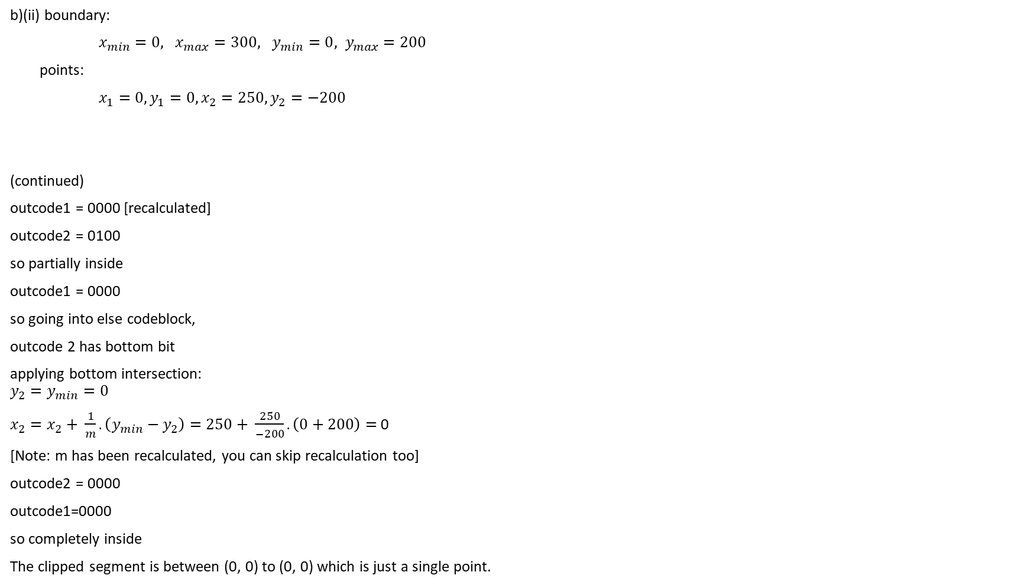
cohen-Sutherland(x1, y1, x2, y2):
oc1 = calculate_outcode(x1, y1),
oc2 = calculate_outcode(x2, y2);
while(true) {
if (oc1 == oc2 == 0000) {
//declare completely inside
output (x1, y1), (x2, y2) as clipped line
break
}
else if ((oc1 AND oc2)!=0000) { // condition to check matching bit
//declare completely outside and clip
break
}
else{
if(oc1 != 0000){
(x1, y1) = find intersection point of line
and the boundary corresponding
to non-zero bit of oc1
oc1 = calculate_outcode(x1, y1)
}
else{
(x2, y2) = find intersection point of line
and the boundary corresponding
to non-zero bit of oc2
oc2 = calculate_outcode(x2, y2)
}
continue
}

Slide 25
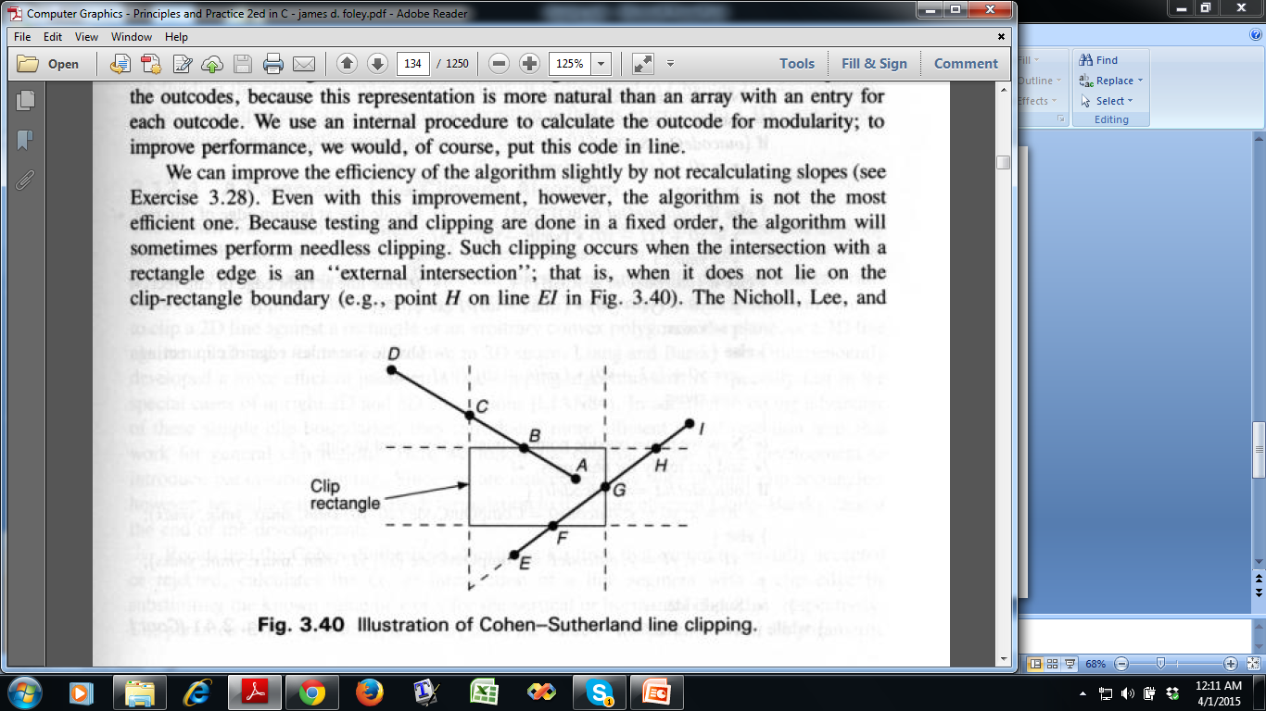
Cohen-Sutherland Line Clipping Algorithm
Works well for two cases:
Very large clip region
Very small clip region
- Why?
[For many trivial accept
and many trivial reject]
Where is the problem?
Unnecessary clipping is done
Different clipping order may take less iterations to finish

Slide 26
Clipping
Cyrus-Beck Algo

Slide 27

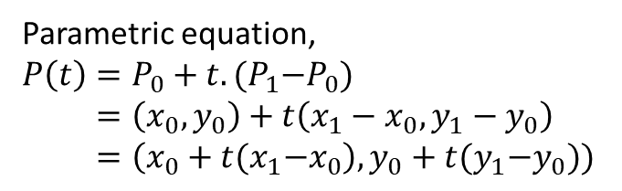


Parametric equation of Line

Slide 28
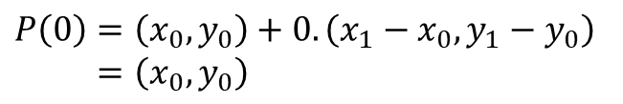

Parametric equation of Line

Slide 29

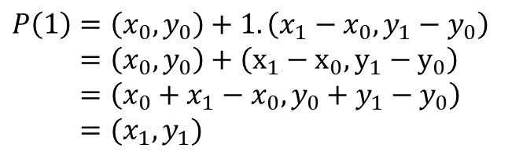
Parametric equation of Line

Slide 30
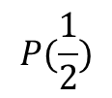
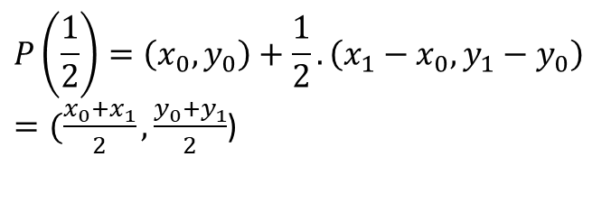
Parametric equation of Line

Slide 31

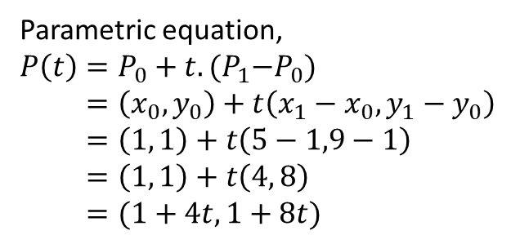


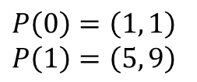
Parametric equation of Line
Suppose, endpoints of a line are (1, 1) and (5, 9)

Slide 32



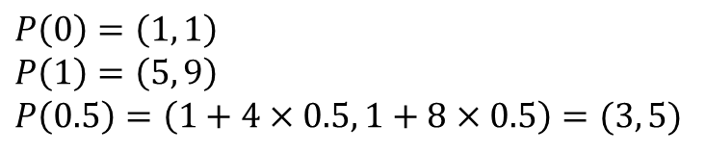
Parametric equation of Line
Suppose, endpoints of a line are (1, 1) and (5, 9)

Slide 33



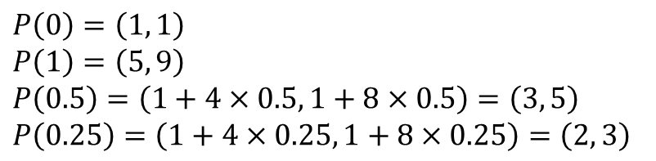
Parametric equation of Line
Suppose, endpoints of a line are (1, 1) and (5, 9)

Slide 34
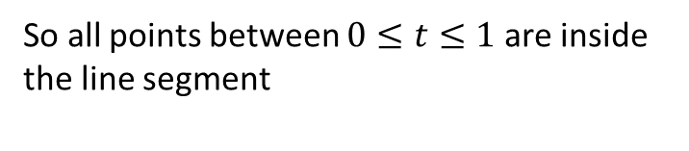
Parametric equation of Line
Suppose, endpoints of a line are (1, 1) and (5, 9)

Slide 35



Parametric equation of Line
Suppose, endpoints of a line are (1, 1) and (5, 9)
P(-0.3) and P(1.3) are outside the line segment

Slide 36
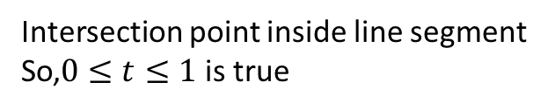
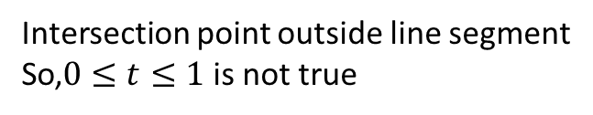
boundary
boundary

Slide 37




P₁
Window
y_{max}
Both endpoints outside
All intersections have t between 0 and 1
y_{min}
P₀
x_{min}
x_{max}

Slide 38




Window
y_{max}
P₁
Both endpoints inside
All intersections have t outside 0 to 1
P₀
y_{min}
x_{min}
x_{max}

Slide 39
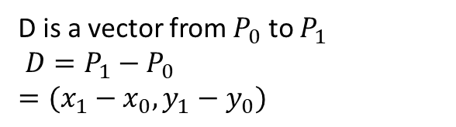
Vector
P₁
D
P₀

Slide 40
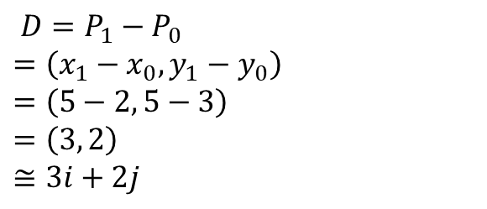
Vector
P₁ (5,5)
D
P₀ (2,3)

Slide 41

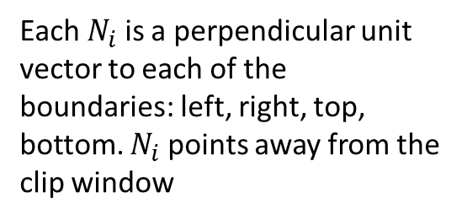



Normal vectors to boundary

Slide 42


Normal vectors to boundary
D = P₁ -P₀
P₁
When angle between N_{i} and D is more than 90 degree-
Or, N_{i} . D < 0
The intersection point is PE
(Potentially entering)
PL
PE
When angle between N_{i} and D is less than 90 degree-
Or, N_{i} . D > 0
The intersection point is PL
(Potentially leaving)
P₀

Slide 43
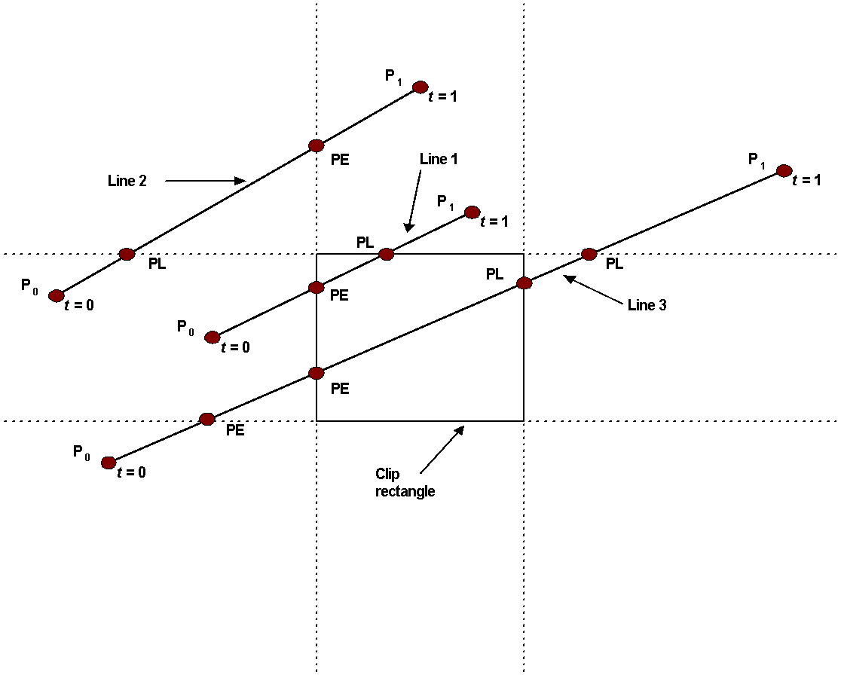
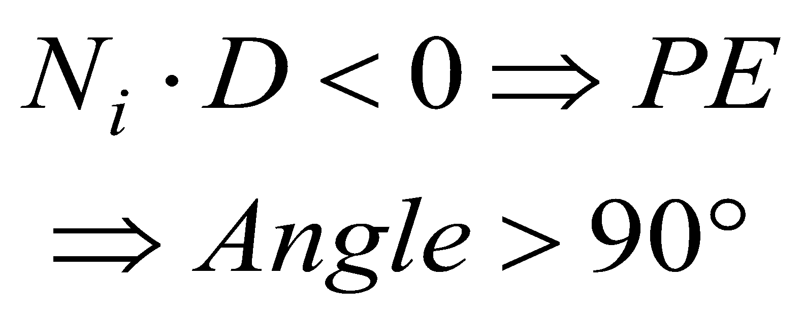
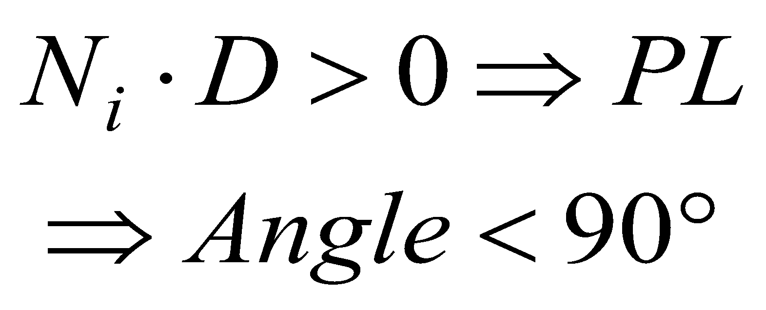
PE = Potentially Entering
PL = Potentially Leaving

Slide 44
Cyrus-Beck algo
Calculate t values of intersection points with each 4 boundaries
Classify intersection points whether PE/PL
Select the PE with highest t and the PL with the lowest t
Using parametric line eqn. find the clipped points

Slide 45
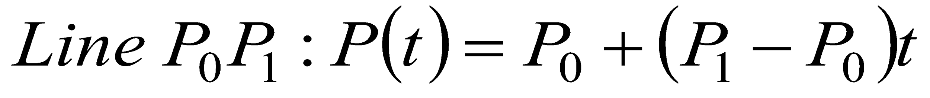
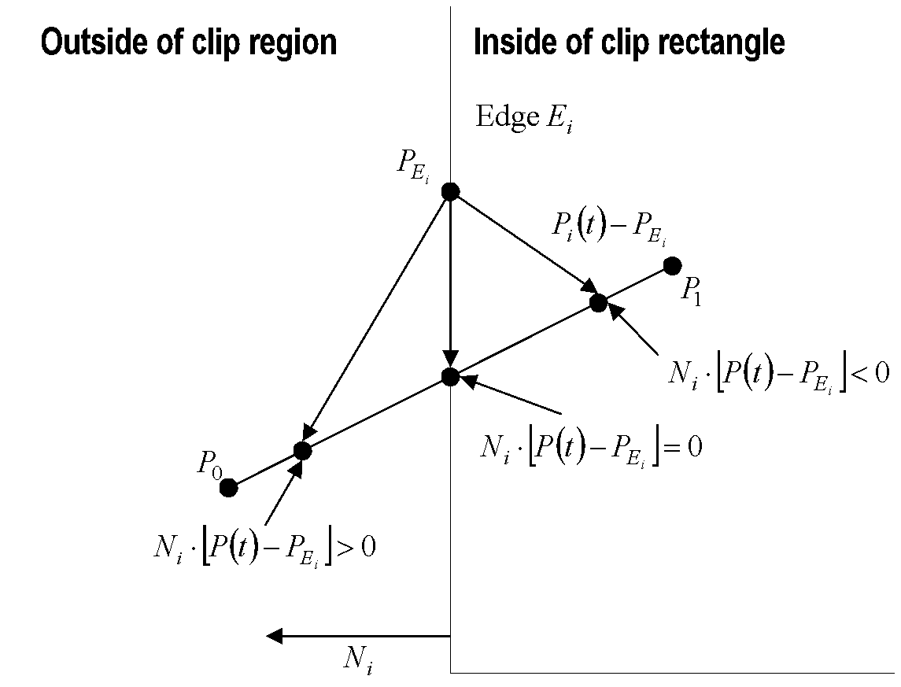
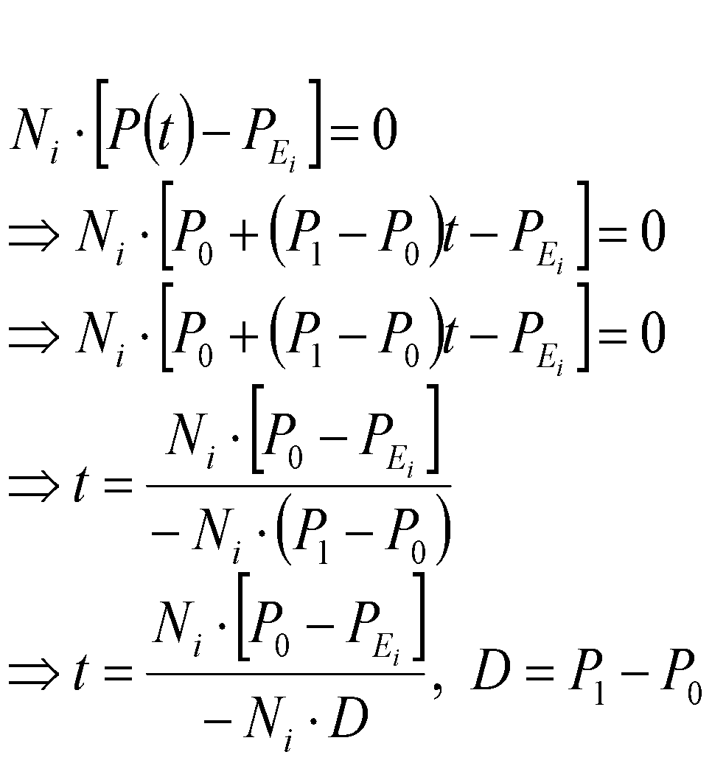
The Cyrus-Beck Algorithm

Slide 46
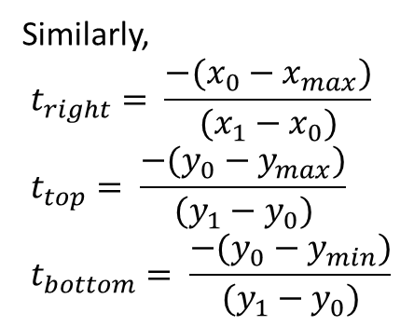
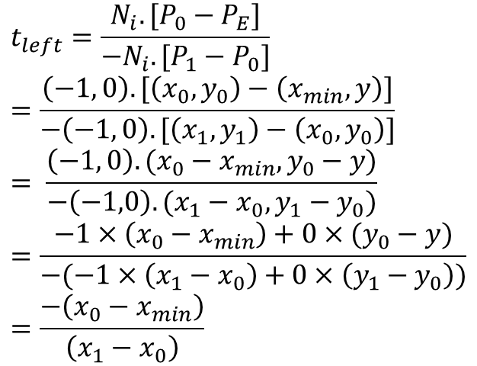
The Cyrus-Beck Algorithm
For left boundary,

Slide 47
The Cyrus-Beck Algorithm
Precalculate N_{i} and P_{Ei} for each edge
for (each line segment to be clipped) {
if (P₁ == P₀)
line is degenerated, so clip as a point;
else {
t_{E} = 0; t_{L} = 1;
for (each candidate intersection with a clip edge) {
if (N_{i} • D != 0) { /* Ignore edges parallel to line */
calculate t;
use sign of N_{i} • D to categorize as PE or PL;
if (PE) t_{E} = max(t_{E} , t);
if (PL) t_{L} = min(t_{L} , t); }
}
if (t_{E} > t_{L}) return NULL;
else return P(t_{E}) and P(t_{L}) as true clip intersection;
}
}

Slide 48
a) Calculate the value of t of the lines given below for all edges and specify whether they are entering or leaving t. [Given (0,0) to (300,200) be the clip region.]
(i) (50, -125) to (-100, 225).
(ii) (-250, 200) to (250, -200).
(iii) (-250, 200) to (150, 100)
Also, find the line segment within the clipping window

Slide 49
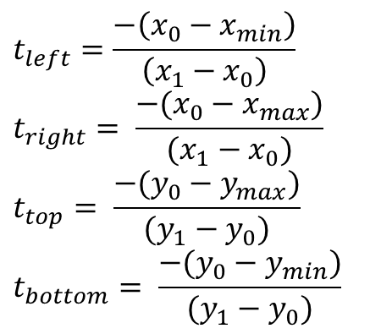
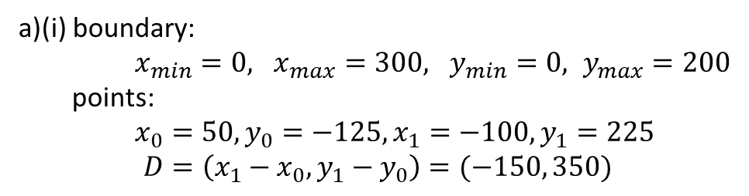

Boundary | N_{i} | N_{i} .D | t | PE/PL | t_{E} | t_{L}
Left | (-1,0) | 150 | 0.33 | PL | 0 | 0.33
Right
Bottom
Top
Algorithm
Precalculate N_{i} and P_{Ei} for each edge
for (each line segment to be clipped) {
if (P₁ == P₀)
line is degenerated, so clip as a point;
else {
t_{E} = 0; t_{L} = 1;
for (each candidate intersection with a clip edge) {
if (N_{i} • D != 0) { /* Ignore edges parallel to line */
calculate t;
use sign of N_{i} • D to categorize as PE or PL;
if (PE) t_{E} = max(t_{E} , t);
if (PL) t_{L} = min(t_{L} , t); }
}
if (t_{E} > t_{L}) return NULL;
else return P(t_{E}) and P(t_{L}) as true clip intersection;
}
}

Slide 50
Boundary | N_{i} | N_{i} .D | t | PE/PL | t_{E} | t_{L}
Left | (-1,0) | 150 | 0.33 | PL | 0 | 0.33
Right | (1,0) | -150 | -1.67 | PE | 0 | 0.33
Algorithm
Precalculate N_{i} and P_{Ei} for each edge
for (each line segment to be clipped) {
if (P₁ == P₀)
line is degenerated, so clip as a point;
else {
t_{E} = 0; t_{L} = 1;
for (each candidate intersection with a clip edge) {
if (N_{i} • D != 0) { /* Ignore edges parallel to line */
calculate t;
use sign of N_{i} • D to categorize as PE or PL;
if (PE) t_{E} = max(t_{E} , t);
if (PL) t_{L} = min(t_{L} , t); }
}
if (t_{E} > t_{L}) return NULL;
else return P(t_{E}) and P(t_{L}) as true clip intersection;
}
}

Slide 51
Boundary | N_{i} | N_{i} .D | t | PE/PL | t_{E} | t_{L}
Left | (-1,0) | 150 | 0.33 | PL | 0 | 0.33
Right | (1,0) | -150 | -1.67 | PE | 0 | 0.33
Bottom | (0, -1) | -350 | 0.36 | PE | 0.36 | 0.33
Algorithm
Precalculate N_{i} and P_{Ei} for each edge
for (each line segment to be clipped) {
if (P₁ == P₀)
line is degenerated, so clip as a point;
else {
t_{E} = 0; t_{L} = 1;
for (each candidate intersection with a clip edge) {
if (N_{i} • D != 0) { /* Ignore edges parallel to line */
calculate t;
use sign of N_{i} • D to categorize as PE or PL;
if (PE) t_{E} = max(t_{E} , t);
if (PL) t_{L} = min(t_{L} , t); }
}
if (t_{E} > t_{L}) return NULL;
else return P(t_{E}) and P(t_{L}) as true clip intersection;
}
}

Slide 52
Boundary | N_{i} | N_{i} .D | t | PE/PL | t_{E} | t_{L}
Left | (-1,0) | 150 | 0.33 | PL | 0 | 0.33
Right | (1,0) | -150 | -1.67 | PE | 0 | 0.33
Bottom | (0, -1) | -350 | 0.36 | PE | 0.36 | 0.33
Top | (0, 1) | 350 | 0.93 | PL | 0.36 | 0.33
Algorithm
Precalculate N_{i} and P_{Ei} for each edge
for (each line segment to be clipped) {
if (P₁ == P₀)
line is degenerated, so clip as a point;
else {
t_{E} = 0; t_{L} = 1;
for (each candidate intersection with a clip edge) {
if (N_{i} • D != 0) { /* Ignore edges parallel to line */
calculate t;
use sign of N_{i} • D to categorize as PE or PL;
if (PE) t_{E} = max(t_{E} , t);
if (PL) t_{L} = min(t_{L} , t); }
}
if (t_{E} > t_{L}) return NULL;
else return P(t_{E}) and P(t_{L}) as true clip intersection;
}
}
Since t_{E} > t_{L} , line segment is outside clip window

Slide 53
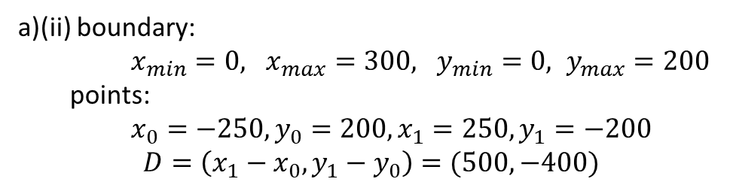

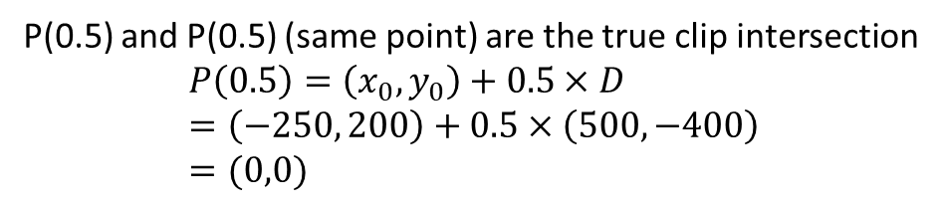
Boundary | N_{i} | N_{i} .D | t | PE/PL | t_{E} | t_{L}
Left | (-1,0) | -500 |  | PE | 0.5 | 1
Right | (1,0) | 500 |  | PL | 0.5 | 1
Bottom | (0, -1) | 400 |  | PL | 0.5 | 0.5
Top | (0, 1) | -400 |  | PE | 0.5 | 0.5
Algorithm
Precalculate N_{i} and P_{Ei} for each edge
for (each line segment to be clipped) {
if (P₁ == P₀)
line is degenerated, so clip as a point;
else {
t_{E} = 0; t_{L} = 1;
for (each candidate intersection with a clip edge) {
if (N_{i} • D != 0) { /* Ignore edges parallel to line */
calculate t;
use sign of N_{i} • D to categorize as PE or PL;
if (PE) t_{E} = max(t_{E} , t);
if (PL) t_{L} = min(t_{L} , t); }
}
if (t_{E} > t_{L}) return NULL;
else return P(t_{E}) and P(t_{L}) as true clip intersection;
}
}

Slide 54
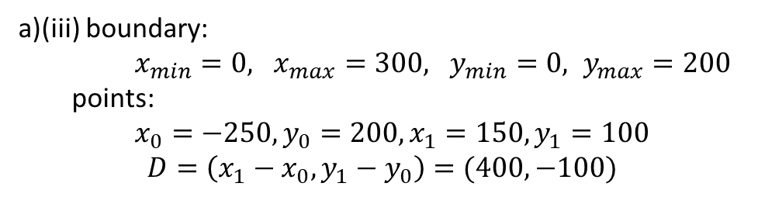

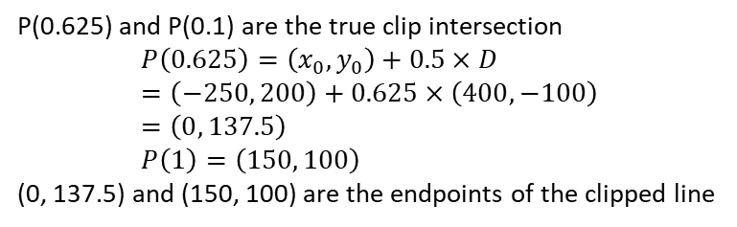
Boundary | N_{i} | N_{i} .D | t | PE/PL | t_{E} | t_{L}
Left | (-1,0) | -400 |  | PE | 0.625 | 1
Right | (1,0) | 400 |  | PL | 0.625 | 1
Bottom | (0, -1) | 100 |  | PL | 0.625 | 1
Top | (0, 1) | -100 |  | PE | 0.625 | 1
Algorithm
Precalculate N_{i} and P_{Ei} for each edge
for (each line segment to be clipped) {
if (P₁ == P₀)
line is degenerated, so clip as a point;
else {
t_{E} = 0; t_{L} = 1;
for (each candidate intersection with a clip edge) {
if (N_{i} • D != 0) { /* Ignore edges parallel to line */
calculate t;
use sign of N_{i} • D to categorize as PE or PL;
if (PE) t_{E} = max(t_{E} , t);
if (PL) t_{L} = min(t_{L} , t); }
}
if (t_{E} > t_{L}) return NULL;
else return P(t_{E}) and P(t_{L}) as true clip intersection;
}
}

Slide 55
Cyrus-Beck Parametric Line Clipping Algorithm
Advantage
Works with polygons too (not only with clip rectangles)
Works in 3D scenario (polyhedrons)
Problem
Does not work with concave polygon clip region
t_{E} = t₃
t_{L} = t₂
t_{E} > t_{L}
So the whole line is discarded though some segments should be displayed
t3
t4
t1
t2
PL
PL
PE
PE

Slide 56
Clipping
Sutherland-Hodgman Polygon Clipping

Slide 57
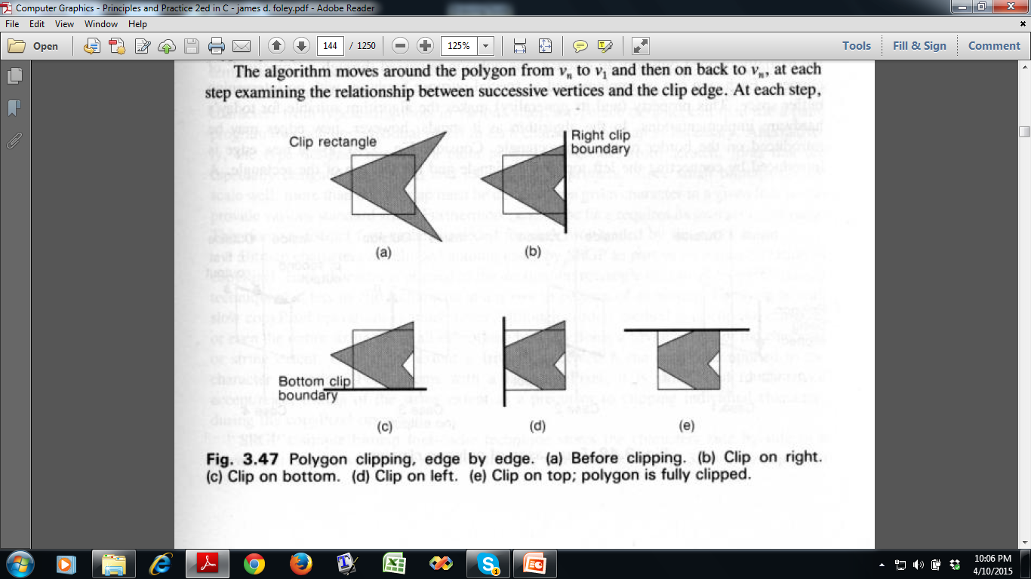
Sutherland-Hodgman Polygon Clipping

Slide 58
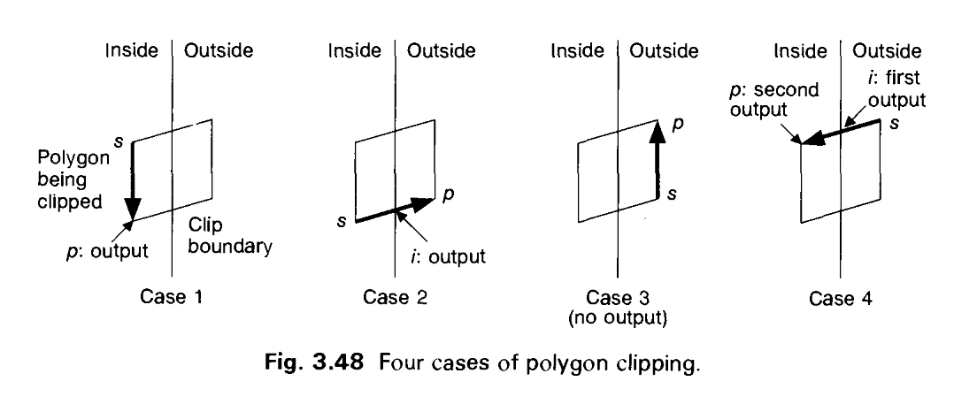
Sutherland-Hodgman Polygon Clipping
Divide and Conquer Strategy
Clip against a single infinite clip edge and get new vertices
Repeat for next clip edge
Adding Vertices to Output List

Slide 59
Sutherland-Hodgman Polygon Clipping
Input:
Polygon described by an input of list of vertices: v₁, v₂, …,v_{n}
Convex clip region C
Algorithm:
Inputlist : v₁, v₂, …,v_{n}
For each clip edge e in E do
S 🡨 v_{n}
P 🡨 v₁
j 🡨 1
While (j<n)
do, if both S & P inside the clip region,
Add p to output list else if S inside & P outside, then Find intersection point i Add i to output list else if S outside and P inside, then find intersection point i add i to output list add P to output list else if S and P both outside do nothing
S 🡨 v_{j}
P 🡨 v_{j+1}
i ++
inputlist 🡨 current output list

Slide 60
Sutherland-Hodgman Polygon Clipping
a
b
a, b, c, d, e, f, g
S = g, P = a
Output: 1, 2, c, d, e, f, g
1
2
e
g
d
f
c
SP | Intersection | Output | Comments
g, a | 1 | 1 | g inside, a outside
a, b | - | - | Both outside
b, c | 2 | 2,c | b outside, c inside
c, d | - | d | Both inside
d, e | - | e | Both inside
e, f | - | f | Both inside
f, g | - | g | Both inside

Slide 61
Sutherland-Hodgman Polygon Clipping
a
b
Output of previous iteration 1, 2, c, d, e, f, g
S = g, P = 1
Output: 3, 1, 4, 5, d, e, f, 6
4
1
2
3
e
6
g
d
f
5
c
SP | Intersection | Output | Comments
g,1 | 3 | 3,1 | g outside, 1 inside
1, 2 | 4 | 4 | 1 inside, 2 outside
2, c | - | - | Both outside
c, d | 5 | 5,d | d inside, c outside
d, e | - | e | Both inside
e, f | - | f | Both inside
f, g | 6 | 6 | f inside, g outside

Slide 62
Sutherland-Hodgman Polygon Clipping
b
a
b
Output of previous iteration 3, 1, 4, 5, d, e, f, 6
S = 6, P = 3
Output: 3, 1, 4, 7, 8, e, 9, 10, 6
4
1
2
3
e
6
g
9
8
10
7
d
f
5
c
SP | Intersection | Output | Comments
6, 3 | - | 3 | Both inside
3, 1 | - | 1 | Both inside
1, 4 | - | 4 | Both inside
4, 5 | 7 | 7 | 4 inside, 5 outside
5, d | - | - | Both outside
d, e | 8 | 8, e | e inside, d outside
e, f | 9 | 9 | e inside, f outside
f, 6 | 10 | 10, 6 | 6 inside, f outside

Slide 63
Sutherland-Hodgman Polygon Clipping
a
b
Output of previous iteration 3, 1, 4, 7, 8, e, 9, 10, 6
S = 6, P = 3
Output: 3, 1, 4, 7, 11, 12, e, 9, 10, 6
4
1
2
3
e
12
6
g
9
8
11
10
7
d
f
5
c
SP | Intersection | Output | Comments
6, 3 | - | 3 | Both inside
3, 1 | - | 1 | Both inside
1, 4 | - | 4 | Both inside
4, 7 | - | 7 | Both inside
7, 8 | 11 | 11 | 7 inside, 8 outside
8, e | 12 | 12, e | e inside, 8 outside
e, 9 | - | 9 | Both inside
9, 10 | - | 10 | Both inside
10, 6 | - | 6 | Both inside

Slide 64
Clipping Circles (and Ellipses)
Analytical
Intersect circle’s extent (square of size of circle’s diameter) with clip rectangle
Run the algorithm of polygon clipping
No intersect : trivial reject
Intersect : divide into quadrants (and later octants if needed) and repeat
Compute intersection by solving equations
During Scan Conversion
When circle is relatively small or scan conversion is fast
After extent checking scissor on a pixel by pixel basis
Similar Approach for Ellipses!

Slide 65
Thank you ☺

